Slide 1
Contents
Page and Solutions
3 ENERGY
4 Additional Benefits
Our Current Workshops and Entertainment Events
5 Grounding Yourself in an Unstable World
2021: The Year of Fun Quiz
14 Let’s Dance! 80s Bingo Bash!
15 Giddy Up! Horse Racing
16 Make ‘Em Laugh Joke Writing
18 British Business Banter
Virtual Event Leader Specialism
20 Virtual Host Services
24 Happy Clients
25 Corporate Hosting Examples
26 Parties – Children’s & Corporate
28 Like What You See?

Slide 3
ENERGY
The virtual host is the life-blood of a virtual event. If they don’t have the energy, the specific communication skills, organic personality, or they can’t read the demographic and attune their approach accordingly then you’ve just lost business.
From my years of performance, comedy producing expertise, professional workshop creation and facilitation skill sets and up-to-date video communication wizardry, I know just how much it takes to transcend an audience out of their “here’s-another-Zoom-call” slouch and into total engagement and electrifying excitement! Lift them out of the box to a place that totally rocks!
This is my micro niche – building teams and igniting dreams.
Don’t believe me? Drop me a line for a free 10 minute demo to experience it yourself.
What do you have to lose?

Slide 4
Additional Benefits
High energy international virtual events host
Host corporate, children’s, educational, game show, and teambuilding events
Bespoke events can be created
Educational, team-building and comedy events already available to book
Home studio set-up including green screen, 1080dpi camera (the maximum most platforms can handle for bandwidth), 4-part lighting system and lapel microphone
Can supply vetted actors and facilitators for your events
Can forge relationships with other global teambuilding service providers to supply events and collaborate
Technical support for virtual events
£20,000,000 public liability insurance
Licensed Zoom account for professional hosting
Enhanced DBS on the update service for children’s parties
Safer Events Accreditation

Slide 5
Grounding Yourself in an Unstable World
With alternative variant focused on Goal Setting and Personal Development
The last year has been chaotic for a lot of us. A new world is coming about and we don't know where we stand in it if it's even safe to stand in it, and what we want from it. 2021 must be the year of change. Where we decide what we want, what we want to become and how we're going to do it. And it starts with you. This event is about giving you the tools to make the change yourself, to root yourself in the identity you would like to create and to give you simple but effective processes to be able to lay a new foundation that won't be shaken.
In this class, we will be identifying roles in a team, identifying where you are now and where you want to get to (the 7 part pyramid) and I will be teaching you how to replace limiting beliefs with empowering ones while aligning your values. Not only will this class help you within your professional life but I will also be giving you tips on how to improve your lifestyle on a personal level

Slide 7
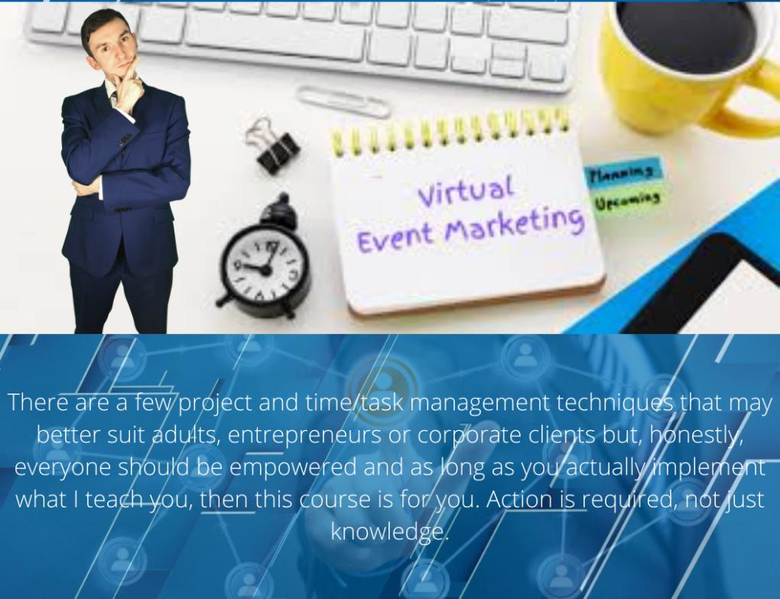

Slide 9
2021: The Year of Fun (Interactive Quiz)
2020 was SO last year...
You’ll need a laptop/tablet and a smartphone to play as we bring the power of interaction back to your fingertips by using your mobile as your answer pad.

Slide 16
Make ‘Em Laugh!
Feel like you could do with a laugh? Join in on this virtual class to learn how to have everyone in stitches. It's a really fun thing to do at home to learn something new and to cheer you up. Whether you're looking to get better at your stand up skills, better at comedy writing or just want to lift your loved ones spirit. There is something for everyone, and it's perfect for beginners. Get all the help you need from experienced teacher, Alex. It's also perfect if you're looking for fun team building activities. It'll be a real virtual gift for your staff as this workshop is sure to put a smile on their face and lift their spirits. It is also so useful for public speaking for all occasions. If you need to put your clients at ease in your professional life or make everyone laugh at your wedding. Give the best speeches with help from Alex. This hilarious virtual experience will cover the science of what makes something funny, types of jokes and how they work, and how to craft jokes out of literally anything. You will even learn how to perform your jokes like a professional! Enter 2021 with a bang and a lot more laughs.

Slide 18
British Business Banter
Join Alex Ranahan as he teaches you the tips and tricks to really make your British clients warm to you. From the type of humour we prefer, to how to create your own British style jokes, even to how to deliver your new sense of humour with effortless style and charisma, you’ll be able to bond with your business partners as the next best thing since sliced bread.
Virtual event includes:
Where British humour stems from culturally, historically and why we laugh at different things.
The science of comedy, why the same joke will get a different response from different scenarios, and how to make your communication more effective.
The different types of auditory and visual jokes and how they work.
Joke vehicles.
How to create jokes out of any given situation and read the room for appropriateness.
How to deliver jokes with confidence, timing and precision.
Why the British truly do always talk about the weather!

Slide 20
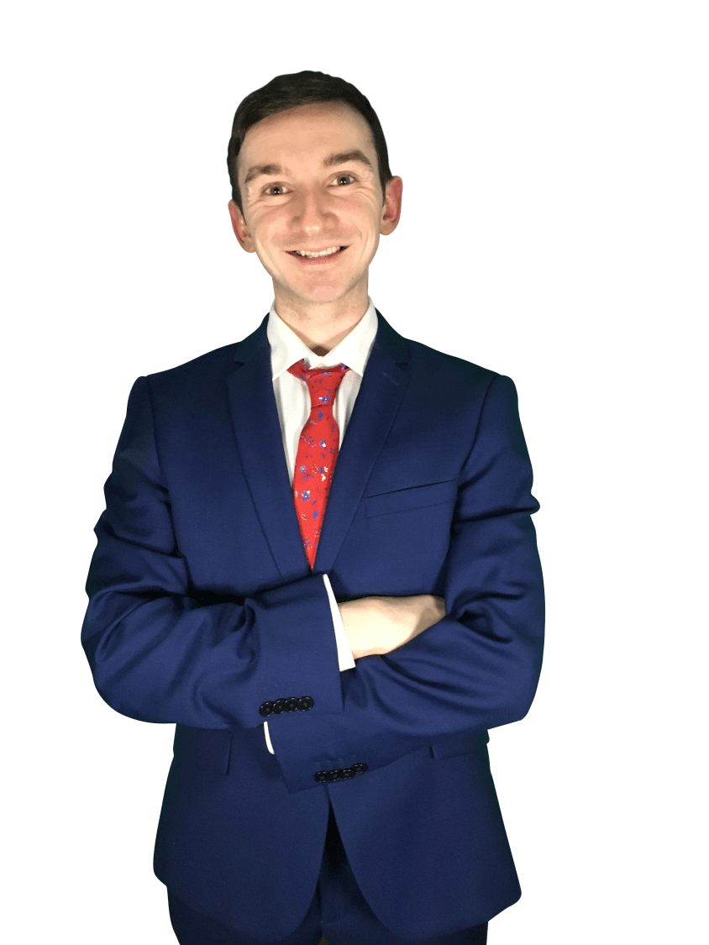
Virtual Event Host Services
Exhilarating your occasion from boring to celebration!
In direct response to the COVID-19 global pandemic, the INTERNET REVOLUTION has rocketed to a new level.
With no access to physical events, yet with the constant need to continually train, inform, educate, entertain and inspire clients, business partners and employees, the world has upgraded to the next stage of communication and entertainment - virtual events.
Now more than ever, it is not only cheaper, quicker, easier and more accessible to host events online, but it is a market demand that will set the standards of the future - Simply put, if you do not market your services or host your events online then your business will die.
Change is being forced so instantaneously around the world that the only way to save your business is to embrace the pandemic and move with it, not against it. The old ways do not work anymore.
To do this, you must have a way to rally your clients, level up your employees, transform business partners into raving fans and to provide a significant experience that will ignite the lives of those in lockdown and give hope and focus during unprecedented times of uncertainty.

Slide 21
It is smarter and far more reliable to hire a professional to ignite your virtual event than to put all your costly efforts into creating a physical event to then have it shut down by another lockdown or, even worse, deadly illness and putting others at risk.
Why wouldn’t you create a relationship with a dependable virtual events presenter rather than attempt to struggle through with an outdated model, guessing your way through a field you aren’t specialised in and running yourself down with superhero syndrome?
Your cost of inaction is far greater.
You cannot do everything yourself and, in this specific industry, you aren’t the best person for the job.
Give it to a performer with over 10 years experience who has worked with multiple companies already accomplishing what you strive to achieve.

Slide 22
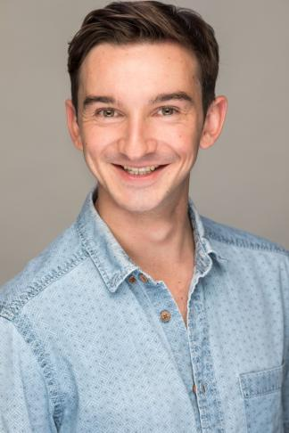
My specialism lies in solving your problem:
Electrifying events.
Uniting teams.
Gifting people with the tools to transform and steer their own lives.
And, most importantly, creating a phenomenal occasion in such grey times.
I bring you the power to take command of this devastating situation and to thrive.
Most big businesses were historically born in a recession - the most successful in adapting seize the opportunity to evolve and take the market share. From collaborating with companies as a host, supplier, strategist, and inventing and running my own virtual events business, I guarantee the events you put your name on are unforgettable and extraordinary.

Slide 23
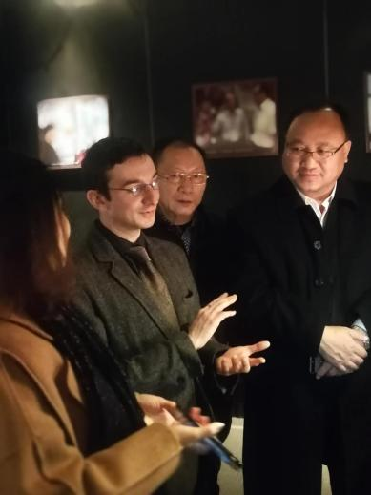
I save you so much hassle:
You must act fast to capture market changes - Trust a professional host to care for your event, freeing you up to do what you best and leave the performing to a professional. Making the most of your time is essential as more people are desperate for your help with the sudden and rising demand of the market. Why wouldn’t you set yourself up for more repeat clients?
We have different knowledge and trained skill sets - Reap the rewards of my cross-pollinated experiences and techniques from working with different companies around the world and their approaches to a variety of virtual events and sectors. Whilst I never share trade secrets from one company to another, my results do the talking: my unique style is a blend of my own development as a performer with over 10 years professional experience, my quick-witted comedy style bolstered by my specialism as an actor, writer and producer of comedy, 2.5 years of honing facilitation development and research, and my focusing on ONE Thing whilst you are new to this style in the industry.
No faff, no learning curve, you can focus on what is urgent and important - Save time on figuring out the technical aspects of online communication platforms such as Zoom, Webex, Remo, and Microsoft Teams. I have worked professionally as a back-end technician for escape rooms, stand-up comedians, variety acts, SpeedQuizzing and my own events.
Less management of human resources - Save more time and money on a team of technicians and event support when I can host and operate the technical side myself!
Less to worry about - Outsource and delegate the hiring and training process of bringing in surplus staff for high demand or bespoke events for that big client. I take the weight off, knowing that I have a pool of vetted professionals and can train them myself.
Ground-level insights - Brainstorm innovative ways of moving forward and taking advantage of projected market opportunities from someone who works internationally with companies from different sectors.
Get the real deal - Invest in a relationship with a presenter who does this full-time, rather than someone who occasionally dips in and out of filling in as ’host’. I’m here for you.
Elevate your brand - Make use of a company that has already invested in professional equipment, rather than relying on ‘getting by’ and representing your company and professional image from a makeshift office in your dining room with a fuzzy webcam.

Slide 24
Happy Clients
Some of the corporate clients I have hosted my own events for include:
Clients I have hosted for on behalf of other companies include:
I also work as a supplier with companies from around the world.
‘I received a number of thank yous from the team to say how great he was and what a good time they had.
Brightened up a pretty pants year.’
Jenny Wills – AMS Group

Slide 25
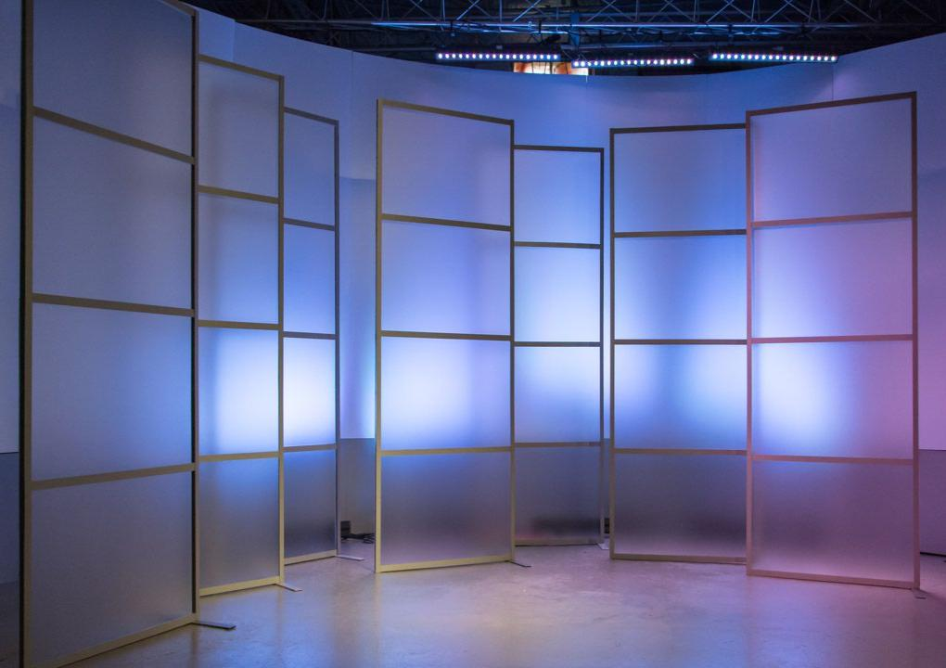
Corporate Hosting Examples
Corporate Studio pink
Master of ceremonies to keep your event on track and understood so that clients make the most of what you have planned for them.
Icebreaker and warm-up leader for either an electrifying or a gentle energiser to get your guests prepped to engage and primed to take action.

Slide 26
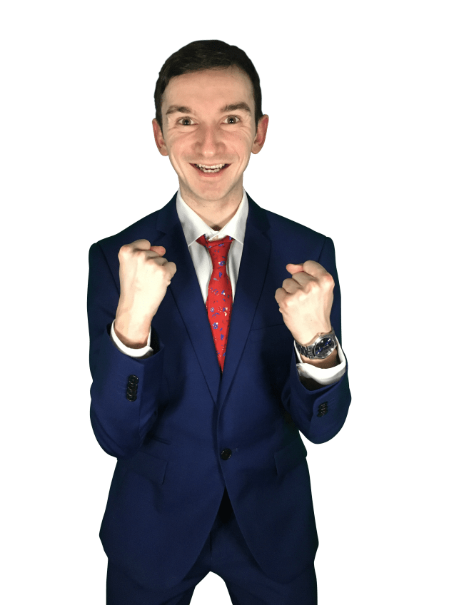
Parties – Children’s & Corporate
As a professional energiser, I know what it takes to give your guests the best time they can have within a 30 to 120 minute slot. Whether it’s your child’s special birthday or celebrating a national holiday or even a treat for hitting that big sales target, I’ve got you covered.
Here’s my high energy
Christmas Crackup!
Here’s my Children’s Party Extravaganza!

Slide 28
Like What You See?
For more information on our services, the events we host and run, or to see what antics we’re up to then drop us an email, a WhatsApp message or, even better, pick up the phone and lets have a chat.
https://alexranahan.co.uk/
info@alexranahan.co.uk
+447794989921
https://www.youtube.com/channel/UCbJqVWVaX8vRVdriNjxHJog
www.linkedin.com/in/alexranahan001
https://www.instagram.com/alexranahan/
https://www.facebook.com/AlexRanahanActor
https://twitter.com/AlexRanahan (@AlexRanahan)
We can deliver an event anywhere in the world – Get in touch for a free 10 minute demo!

